Slide 1
Marching Cubes: A High Resolution 3D Surface Construction Algorithm
William E. Lorensen Harvey E. Cline
General Electric Company
Corporate Research and Development
Schenectady, New York 12301

Slide 2
Problem
construct the 3D surface from multiple 2D slices of information.
Existing 3D algorithms lack detail and sometimes introduce artifacts.

Slide 3
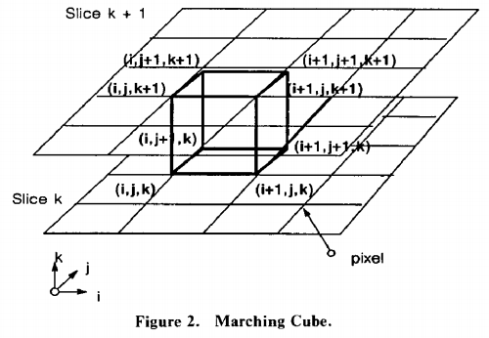
Motivation
Marching cubes uses a divide-and-conquer approach to locate the surface in a logical cube created from eight pixels, four each from two adjacent slices.

Slide 4
Algorithm
First, locate the surface corresponding to a user-specified value and create triangles.
Then, to ensure a quality image of the surface, we calculate the normals to the surface at each vertex of each triangle.

Slide 5
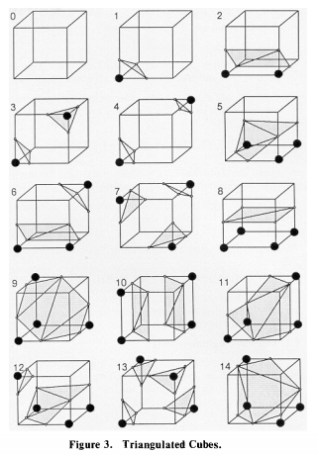
Algorithm
Determine the topology of the surface within a cube, finding the location of the intersection.

Slide 6
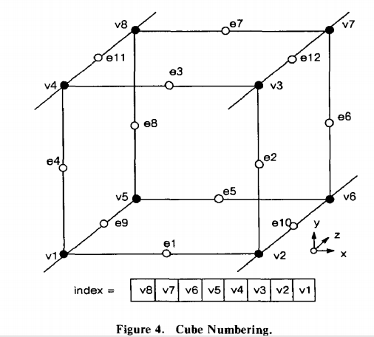
Algorithm
linear interpolation

Slide 7
Algorithm
calculates a unit normal for each triangle vertex.

Slide 8
Algorithm
Read four slices into memory.
Scan two slices and create a cube from 8 neighbors .
Calculate an index for the cube by comparing the eight density values at the cube vertices with the surface constant.
Using the index, look up the list of edges from a precalculated table.
Find the surface edge intersection via linear interpolation.
Calculate a unit normal at each cube vertex using central differences. Interpolate the normal to each triangle vertex.
Output the triangle vertices and vertex normals.

Slide 9
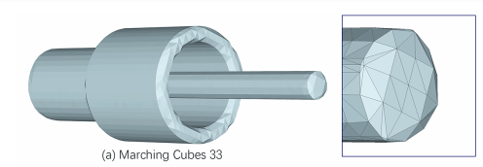
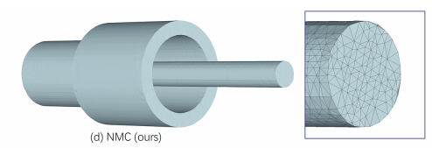
Disadvantage

Slide 10
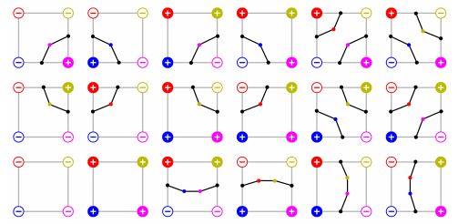
Improvement

